Slide 2
Bioinformatics: DNA identity
08

Slide 3
Teacher notes: Session contents
Interpreting chromatograms | 20 min | Explanation of the data displayed in a chromatogram and how it provides information on the accuracy of the DNA sequence generated. Supporting Interpretation of how accurate the DNA barcode sequences are from the chromatograms, using Chromas (free to download software).
Bioinformatics: BLAST | 20 min | Following the exercise using BLAST (Basic Local Alignment Search Tool), in session 2, applying the same techniques to identify the invertebrates sampled.
Communication: invertebrate identities | 20 min | Sharing information about the invertebrates identified within the class. Is it possible to identify invertebrate samples from the DNA sequence? Has anyone got quality DNA sequence that is not similar to known invertebrates in the database?

Slide 4
Bioinformatics: DNA identity
Communication: invertebrate identities
Interpreting chromatograms
Bioinformatics: BLAST

Slide 5

Interpreting chromatograms
Sanger sequencing using capillary gel electrophoresis produces a chromatogram:
DNA is denatured and a primer anneals to the DNA (just like in PCR)

Slide 6
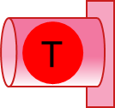
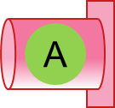
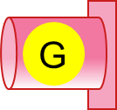
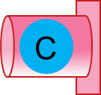
Interpreting chromatograms
Sanger sequencing using capillary gel electrophoresis produces a chromatogram:
DNA is denatured and a primer anneals to the DNA (just like in PCR)
DNA polymerase extends the region of double-stranded DNA (just like in PCR) until a fluorescent terminator nucleotide is added
Single-stranded DNA for sequencing
Fluorescent terminator nucleotides
Nucleotides
DNA polymerase
Primer

Slide 7
Interpreting chromatograms
Sanger sequencing using capillary gel electrophoresis produces a chromatogram:
DNA is denatured and a primer anneals to the DNA (just like in PCR)
DNA polymerase extends the region of double-stranded DNA (just like in PCR) until a fluorescent terminator nucleotide is added

Slide 8
Interpreting chromatograms
Sanger sequencing using capillary gel electrophoresis produces a chromatogram:
DNA is denatured and a primer anneals to the DNA (just like in PCR)
DNA polymerase extends the region of double-stranded DNA (just like in PCR) until a fluorescent terminator nucleotide is added

Slide 9
Interpreting chromatograms
Sanger sequencing using capillary gel electrophoresis produces a chromatogram:
DNA is denatured and a primer anneals to the DNA (just like in PCR)
DNA polymerase extends the region of double-stranded DNA (just like in PCR) until a fluorescent terminator nucleotide is added

Slide 10
Interpreting chromatograms
Sanger sequencing using capillary gel electrophoresis produces a chromatogram:
DNA is denatured and a primer anneals to the DNA (just like in PCR)
DNA polymerase extends the region of double-stranded DNA (just like in PCR) until a fluorescent terminator nucleotide is added

Slide 11
Interpreting chromatograms
Sanger sequencing using capillary gel electrophoresis produces a chromatogram:
DNA is denatured and a primer anneals to the DNA (just like in PCR)
DNA polymerase extends the region of double-stranded DNA (just like in PCR) until a fluorescent terminator nucleotide is added

Slide 12
Interpreting chromatograms
Sanger sequencing using capillary gel electrophoresis produces a chromatogram:
DNA is denatured and a primer anneals to the DNA (just like in PCR)
DNA polymerase extends the region of double-stranded DNA (just like in PCR) until a fluorescent terminator nucleotide is added
This produces fragments of a range of sizes, which can be separated through gel in a narrow capillary by electrophoresis

Slide 13




Interpreting chromatograms
Laser
Sanger sequencing using capillary gel electrophoresis produces a chromatogram:
DNA is denatured and a primer anneals to the DNA (just like in PCR)
DNA polymerase extends the region of double-stranded DNA (just like in PCR) until a fluorescent terminator nucleotide is added
This produces fragments of a range of sizes, which can be separated through gel in a narrow capillary by electrophoresis
As fragments migrate a laser excites the fluorescent terminator base and a detector records the colour on a chromatogram.
Capillary containing gel
Detector
Chromatogram
Fluorescence detected
Time

Slide 14
Interpreting chromatograms
Laser
Sanger sequencing using capillary gel electrophoresis produces a chromatogram:
DNA is denatured and a primer anneals to the DNA (just like in PCR)
DNA polymerase extends the region of double-stranded DNA (just like in PCR) until a fluorescent terminator nucleotide is added
This produces fragments of a range of sizes, which can be separated through gel in a narrow capillary by electrophoresis
As fragments migrate a laser excites the fluorescent terminator base and a detector records the colour on a chromatogram.
Capillary containing gel
Detector
Chromatogram
Fluorescence detected
T
Time

Slide 15
Interpreting chromatograms
Laser
Sanger sequencing using capillary gel electrophoresis produces a chromatogram:
DNA is denatured and a primer anneals to the DNA (just like in PCR)
DNA polymerase extends the region of double-stranded DNA (just like in PCR) until a fluorescent terminator nucleotide is added
This produces fragments of a range of sizes, which can be separated through gel in a narrow capillary by electrophoresis
As fragments migrate a laser excites the fluorescent terminator base and a detector records the colour on a chromatogram.
Capillary containing gel
Detector
Chromatogram
Fluorescence detected
T
T
Time

Slide 16
Interpreting chromatograms
Laser
Sanger sequencing using capillary gel electrophoresis produces a chromatogram:
DNA is denatured and a primer anneals to the DNA (just like in PCR)
DNA polymerase extends the region of double-stranded DNA (just like in PCR) until a fluorescent terminator nucleotide is added
This produces fragments of a range of sizes, which can be separated through gel in a narrow capillary by electrophoresis
As fragments migrate a laser excites the fluorescent terminator base and a detector records the colour on a chromatogram.
Capillary containing gel
Detector
Chromatogram
Fluorescence detected
T
T
C
Time

Slide 17
Interpreting chromatograms
Laser
Sanger sequencing using capillary gel electrophoresis produces a chromatogram:
DNA is denatured and a primer anneals to the DNA (just like in PCR)
DNA polymerase extends the region of double-stranded DNA (just like in PCR) until a fluorescent terminator nucleotide is added
This produces fragments of a range of sizes, which can be separated through gel in a narrow capillary by electrophoresis
As fragments migrate a laser excites the fluorescent terminator base and a detector records the colour on a chromatogram.
Capillary containing gel
Detector
Chromatogram
Fluorescence detected
T
T
C
A
Time

Slide 18
Interpreting chromatograms
Laser
Sanger sequencing using capillary gel electrophoresis produces a chromatogram:
DNA is denatured and a primer anneals to the DNA (just like in PCR)
DNA polymerase extends the region of double-stranded DNA (just like in PCR) until a fluorescent terminator nucleotide is added
This produces fragments of a range of sizes, which can be separated through gel in a narrow capillary by electrophoresis
As fragments migrate a laser excites the fluorescent terminator base and a detector records the colour on a chromatogram.
Capillary containing gel
Detector
Chromatogram
Fluorescence detected
T
T
C
A
G
Time

Slide 19
Interpreting chromatograms
Sanger sequencing using capillary gel electrophoresis produces a chromatogram. The results of the chromatogram are used to produce a FASTA (Fast-All) file too.
Chromatogram
Fluorescence detected
T
T
C
A
G
Time
>Sequence name
TTCAGGTACAGGATACAATAGACTTAGACATAGGCATAGCACCCAGATAGGCGGCTGCAATGCATACAGCCCCGAGGGGTTACA

Slide 20
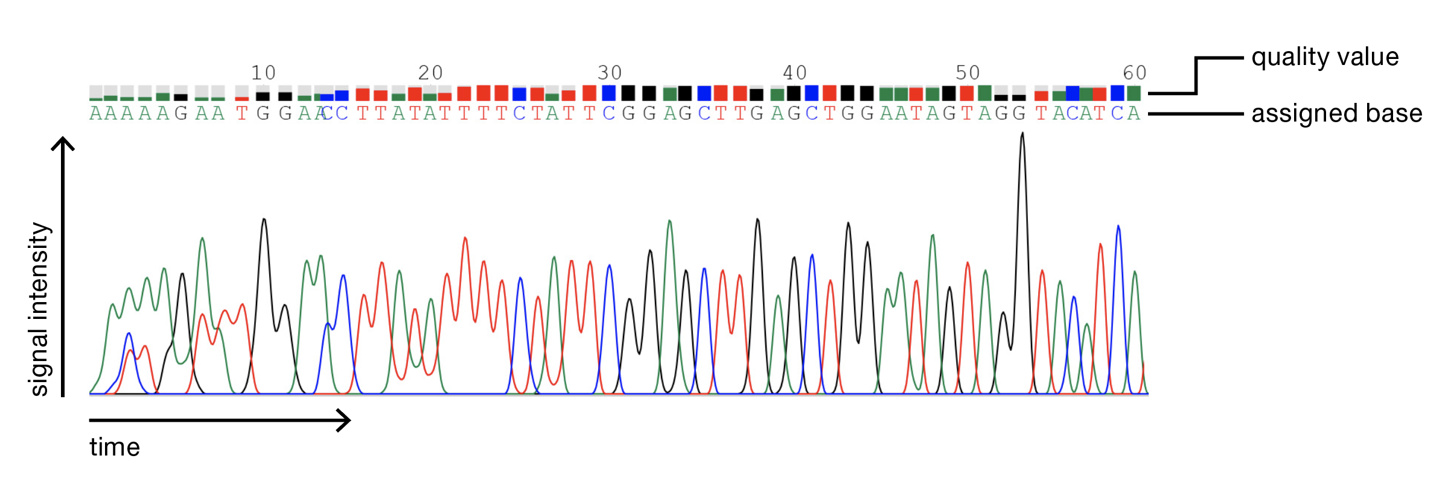
Interpreting chromatograms
Chromatograms show the strength of the fluorescent signal from a nucleotide, plotted against time (as an indication of where that nucleotide is in the DNA sequence).
Each base has a differently coloured fluorescent tag:
A = green
C = blue
G = yellow
T = red

Slide 21
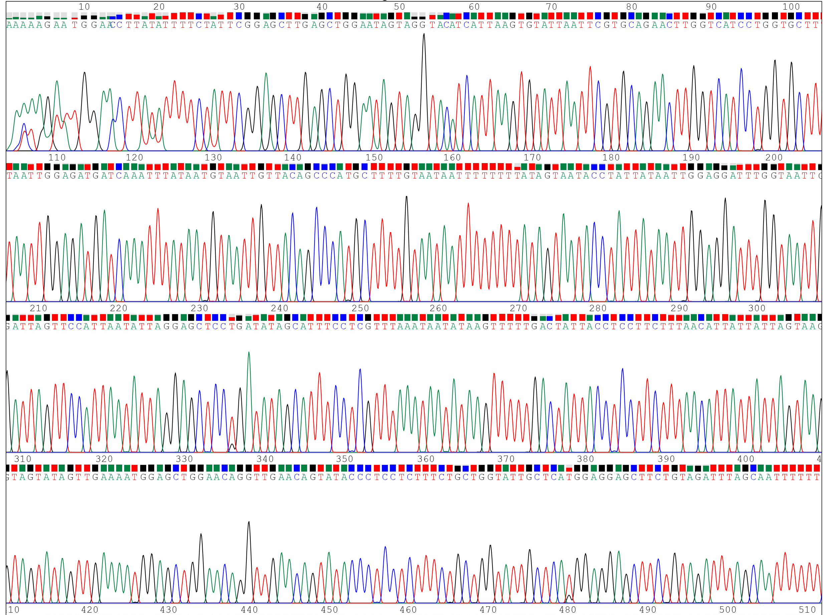
Interpreting chromatograms
On a chromatogram:
Good quality, accurate DNA sequence is seen as sharp, evenly-spaced peaks
The 1st 40 base sequence is often poor
The best DNA sequence data is usually found between 100 and 500 bases
The quality of DNA sequence data often deteriorates towards the end of the trace

Slide 22
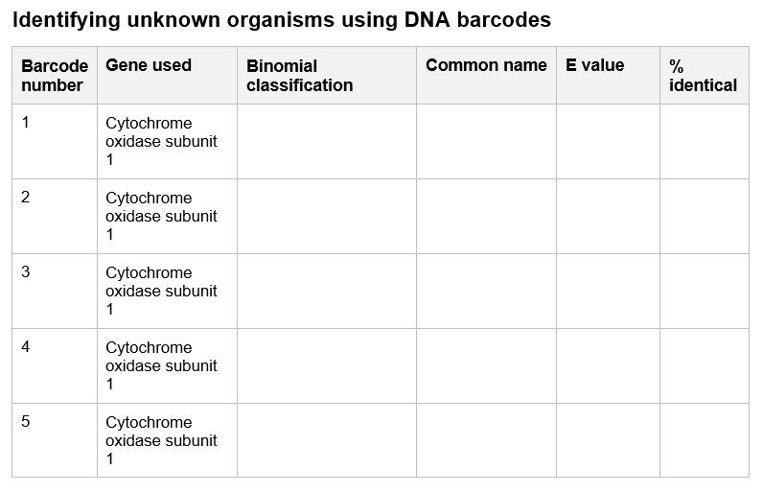

Interpreting chromatograms

Find the chromatogram file for your DNA barcode.
Follow the printed or digital instructions to view your chromatogram
Save the chromatogram in a file format, location and using a file name that you will be able to find and use again
Discuss the accuracy of your DNA barcode sequence (using information from the chromatogram)


Slide 23
Bioinformatics: DNA identity
Communication: invertebrate identities
Interpreting chromatograms
Bioinformatics: BLAST

Slide 24

Bioinformatics: BLAST
Bioinformatics is the development of software and computing tools to organise and analyse raw biological data.
One way in which bioinformatics is used is for the comparison of DNA sequence.
Comparison of DNA sequence from known organisms determines how similar DNA sequence is and relatedness.
Comparison of DNA sequence from an unknown organism to a database of DNA sequences assists identification.

Slide 25



Bioinformatics: BLAST
To compare DNA sequences, a BLAST is used.
BLAST stands for Basic Local Alignment Search Tool.
Compare the DNA barcode sequence from your invertebrate sample to a database of DNA sequences to try and identify what it is.
?

Slide 26
Bioinformatics: BLAST

Find your DNA barcode sequence file
Follow the printed or digital instructions to compare these DNA barcodes to the NCBI (National Centre for Biotechnology Information) database using a BLAST
Save the DNA barcode sequence in a file format, location and using a file name that you will be able to find and use again
Record the binomial classification, common name, E value and % identical – you can use the form from session 2 named ’02_R_BLAST-results’ as a template if it is helpful



Slide 27
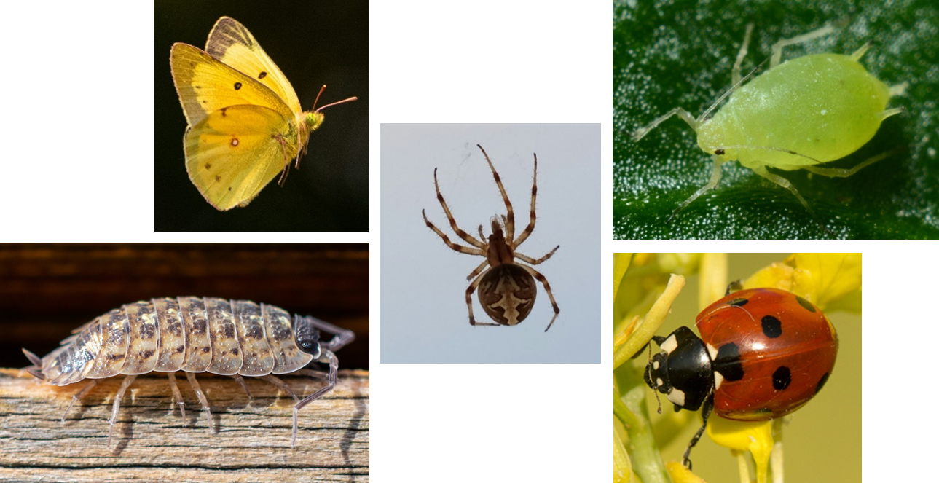
Bioinformatics: BLAST
Prepare to present your results to the class:
Is it possible to identify your invertebrate sample from the DNA sequence?
How accurate is your DNA sequence? (Judged from the chromatogram.)
What do the E value and % identical tell you about how good the DNA barcode sequence match to the database is?
Has anyone got accurate DNA sequence that is not similar to known invertebrates in the database?

Slide 28
Bioinformatics: DNA identity
Communication: invertebrate identities
Interpreting chromatograms
Bioinformatics: BLAST

Slide 29
Barcoding basics
What can you do with your DNA-based identification of an invertebrate species?
If the DNA barcode from your invertebrate matches one in the database, you will contribute to knowledge about the range and habitats of invertebrates found around your school: Biomonitoring
If the DNA barcode from your invertebrate does not match one in the database, your sample could be used in further analysis to try and characterise an unknown invertebrate: Bioexploration

Slide 30
Bioinformatics: BLAST
As a class:
Is it possible to identify invertebrate samples from the DNA sequence for use in biomonitoring?
How accurate is the DNA sequence? (Judged from the chromatogram.)
What do the E value and % identical tell you about how good the DNA barcode sequence match to the database is?
Has anyone got accurate DNA sequence that is not similar to known invertebrates in the database and could be used in bioexploration?

Slide 31
Bioinformatics: DNA identity
Communication: invertebrate identities
Interpreting chromatograms
Bioinformatics: BLAST
Next session we be starting to design posters to communicate our results / producing a phylogenetic tree of the invertebrates identified [delete as appropriate].

Slide 32
Thank you
Barcoding for beginners is a project by Wellcome Connecting Science, funded by a Royal Society Partnership grant.
All resources can be found on YourGenome: yourgenome.org/theme/barcoding-for-beginners
Image credits Wellcome Connecting Science Insect illustrations: Petra Korlević

